Slide 1
Iowa Electric Vehicle Infrastructure Deployment Plan
Iowa Energy Summit
November 9, 2022
Stu Anderson, Iowa DOT

Slide 2
Agenda
National Electric Vehicle Infrastructure (NEVI) Program
Electric Vehicle (EV) Technology
EV Trends
Iowa’s EV Infrastructure Deployment Plan
What’s Next?

Slide 3
National Electric Vehicle Infrastructure (NEVI) Program
Infrastructure Investment & Jobs Act (IIJA)
NEVI Program
Iowa’s Commitment to Fuel Diversity

Slide 4
IIJA and the NEVI Program
The 2021 Infrastructure Investment and Jobs Act (IIJA), authorized $7.5 billion in federal funds to support electric vehicle (EV) chargers.
$5 billion in formula funds; $2.5 billion discretionary grant program
In February 2022, guidance was issued for the NEVI Program, which provides federal funds for EV charging infrastructure.
To receive funds, states developed plans to create a charging network along major corridors.
Notes:
The Infrastructure Investment and Jobs Act, also called the Bipartisan Infrastructure Law, authorized $7.5 billion in federal funds to support EV chargers.
The NEVI Program provides federal funds: $5 billion for the NEVI Formula Program and a $2.5 billion discretionary grant program.

Slide 5
Iowa’s Approach
Iowa DOT partnered with the Iowa Economic Development Agency (IEDA) to oversee development of an EV Infrastructure Deployment Plan that supports the transportation electrification efforts for Iowa.

Slide 6
Iowa’s Commitment to Fuel Diversity
Iowa is a proud and nationally recognized leader in renewable energy and biodiesel and ethanol production. Our state has made a significant investment in renewable fuels infrastructure. State leaders, local communities, private companies, and utilities are making solid progress to add electric vehicle infrastructure to our diverse fuel mix.
Iowa will remain unwavering in our support for varied fuel resources and associated infrastructure, including ethanol, biodiesel, propane, renewable natural gas, and electric.
Notes:
The state of Iowa has been a leader in embracing new opportunities in clean energy technology to benefit its residents, economy and the environment. Renewable energy production continues to grow while more citizens, businesses and visitors desire to power their vehicles sustainably. As technology continues to evolve, more challenges and opportunities will present themselves, and the state will continue to respond to the ever-changing environment as a leader in renewable energy production.
This approach is also consistent with the Iowa Energy Plan that was developed in 2016, under the leadership of then-Lt. Governor Kim Reynolds, which included support for alternative fuel vehicles as a key focus area and prioritizing interstate corridors.

Slide 7
EV Technology
Types of Electric Vehicles
EV Charging Stations
Notes:
Mark

Slide 8
Types of Electric Vehicles
HYBRID ELECTRIC VEHICLES
PLUG-IN HYBRID ELECTRIC VEHICLES
ALL ELECTRIC OR BATTERY ELECTRIC VEHICLES
FUEL CELL ELECTRIC VEHICLES
Notes:
There are varying types of EVs on the market and many technologies are developing.
Plug In Hybrid – Onboard battery that charges using a plug in. The battery is small and range varies by manufacturer. Typically these vehicles range from 20 to 50 mile range on a full battery and are good for traveling around town or for commuting.
Hybrid electric – Onboard battery that charges while the vehicle brakes during normal operation. The vehicle never plugs in. The battery helps to increase the vehicle mileage (mpg)
Fuel Cell EVs – still developing this technology. Don’t plug in or produce emissions.
All Electric or Battery Electric Vehicles– all charging and propulsion done using electricity and electric engine. Most manufacturers are shooting for ~300 miles per battery charge. This is what the plan is primarily aiming to address.

Slide 9
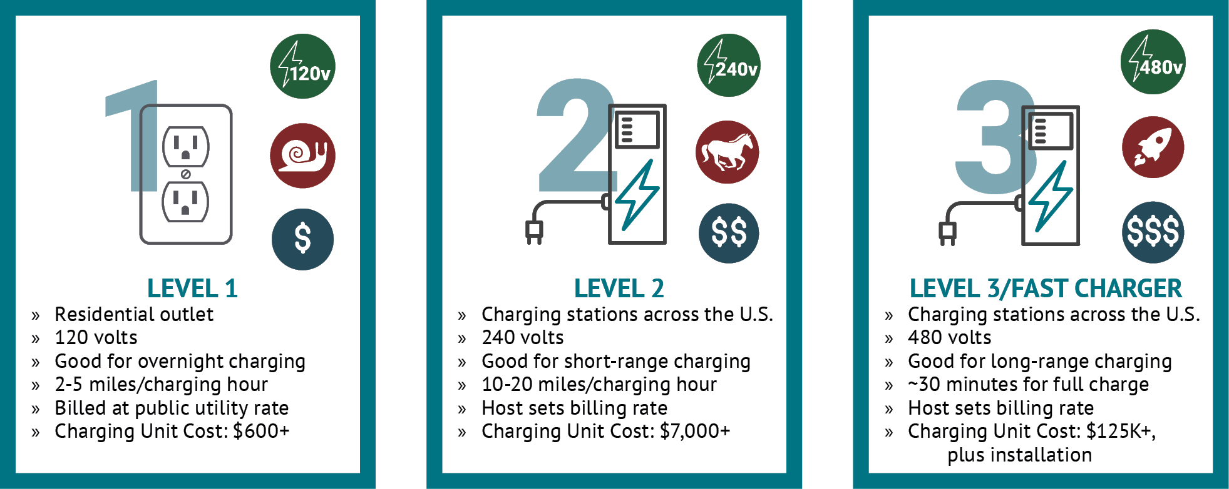
EV Charging Stations LEVEL 1, LEVEL 2 & LEVEL 3
Notes:
Currently, there are three levels of EV chargers.
Level 1 is a typical residential outlet. It charges very slowly and is best for overnight. The cost for electricity is billed similar to other energy usage from a utility.
Level 2 chargers are faster, and can provide between 10 to 20 miles of range per hour of charging. These types of chargers are good for users with short-range needs, i.e. going across town, charging while in a grocery store, etc. The cost for usage is set by the host of the charging site, similar to how a convenience store sets the cost of gasoline.
Level 3 chargers are the fastest type of existing charging stations. This is what NEVI is addressing. Also called fast chargers, these can provide nearly a full charge in around 30 minutes. The charging set host sets the billing rate.

Slide 10
EV Trends
Nationally
Within Iowa
Notes:
Mark (Amanda introduce Mark)

Slide 11
National Trends
U.S. electric car sales jumped to a record high of over 200,000 vehicles in Q1 2022.
Electric vehicle (EV) sales continue to grow in the U.S. as automakers build more options and consumers drive the demand.
Notes:
Mark

Slide 12
EVs in Iowa Today
With statewide growing adoption, 10,350 EVs and hybrid vehicles were registered in Iowa as of June 2022— at least one was registered in every county.
To support this growth, Iowa has 270 EV charging locations (Level 2 and 3) across the state for public use.
 | Battery Electric Vehicles | Plug-In Hybrid Electric Vehicles
April 2017 | 400
June 2018 | 700 | 1,750
June 2019 | 1,340 | 2,400
June 2021 | 3,200 | 3,180
June 2022 | 5,740 | 4,610
Notes:
As of April 2022, an estimated 9,400 electric vehicles are registered in Iowa.
Iowa DOT estimates 5,000 represent all electric and 4,400 plug-in hybrid vehicles.
To support the growing popularity for Evs in Iowa, over 270 public charging stations are available, representing Level 2 or Level 3 fast charging stations.
However, the NEVI plan is aimed at long-range travelers, who may come from outside of the state.

Slide 13
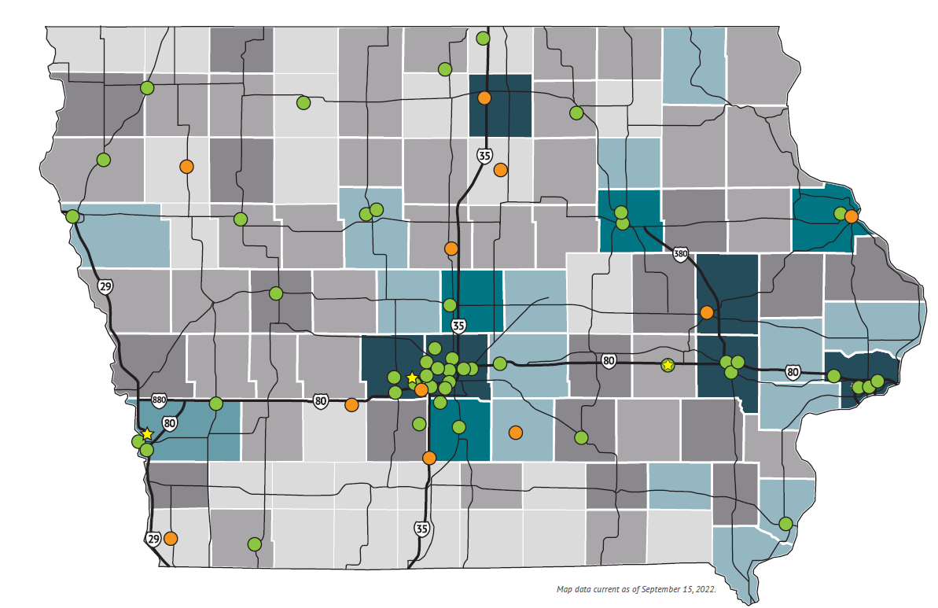
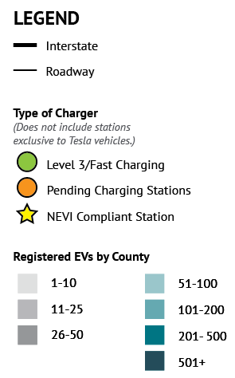
Iowa’s Existing & Future Stations
View the map at: iowadot.gov/IowaEVPlan
Notes:
Presently, only three NEVI compliant sites in the state. Many of the pending stations will fit some of the NEVI criteria. We will go over what that means later in the presentation.

Slide 14
Projected EVs on the Road in Iowa
Notes:
Based on forecasted estimates, DOT projects between 230k and 450k EVs in the state by 2040.

Slide 15
Electrical Vehicle Infrastructure Deployment Plan
NEVI Requirements
Alternative Fuel Corridors
Notes:
Mark

Slide 16
NEVI Requirements for State EV Plans
Allow access to public and commercial fleet operators
Prioritize EV charging stations along designated corridors
Address needs for EV charging infrastructure in rural corridors and under-served or disadvantaged communities
Provide long-term operation and maintenance
Include existing EV charging infrastructure programs and incentives
Catalyze additional private investment
Consider consumer protection, cyber-security, domestic manufacturing, emergency evacuation planning, environmental permitting, resilience, and terrain related issues

Slide 17
Iowa’s EV Alternative Fuel Corridors
Notes:
Stu or Craig

Slide 18
NEVI Requirements for Charging Stations
<1 mile
<1 mile
<50 miles
<50 miles
Along Alternative Fuel Corridors
<50 mile spacing; <1 mile away
At least four 150 kW DC Fast Charging ports
Open to general public (not proprietary)
Need to build out corridors before going off-corridor

Slide 19
What’s Next?
Schedule
Stay Informed
Notes:
Mark

Slide 20
EV INFRASTRUCTURE DEPLOYMENT PLAN Schedule
Iowa’s EV Plan Approved by Joint Office
LATE WINTER 2022/23
EV Program Rollout Begins

Slide 21
Stay Informed
Visit the website: iowadot.gov/IowaEVPlan
Understand the grant cycle and when funding is expected to be available
Start conversations with your peers and communities
This is just the beginning of a five-year process
Iowa.EvPlan@iowadot.us
Notes:
Funding cycle is still a work in progress – check in periodically

