Slide 1
Introduction to GEBs and GEB Controls
Xiaohui “Joe” Zhou, PhD, PE, CEM
Director of Research and Innovation
2022 Iowa Energy Summit
Altoona, Iowa
11/09/2022

Slide 2
Who we are
Mission-driven non-profit located in Madison, WI.
Accelerating climate solutions. For everyone.
Nationally recognized technical leadership.
https://slipstreaminc.org/

Slide 3
Outline
GEB
GEB Controls
ADR Through GEB Controls
What is a GEB?
Three components of a GEB control platform
Automated Demand Response by controlling the HVAC system in a GEB

Slide 4
GEB

Slide 5
What is a GEB?
A Grid-interactive Efficient Building (GEB) is an energy-efficient building that uses smart end-use equipment and/or other onsite DERs to provide demand flexibility while co-optimizing for energy cost, grid services, and occupant needs and preferences, in a continuous and integrated way.

Slide 6
Distributed Energy Resources (DER)
Behind-the-Meter Generation
Photovoltaics
Gas-Fired Generation, Combined Heat and Power, Fuel Cells
Energy Storage
Battery
Cool Thermal and Refrigeration
Advanced Inverters
Electric Vehicles
Advanced Building Controls

Slide 7
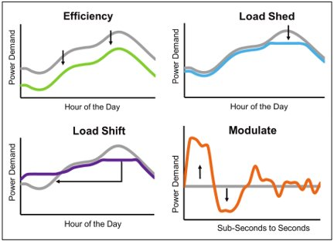
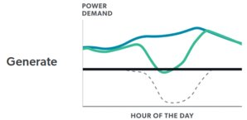
Why DERs in Buildings
Modes of Building Load Flexibility
+
Source: 2019 DOE Grid-interactive Efficient Buildings Overview

Slide 8
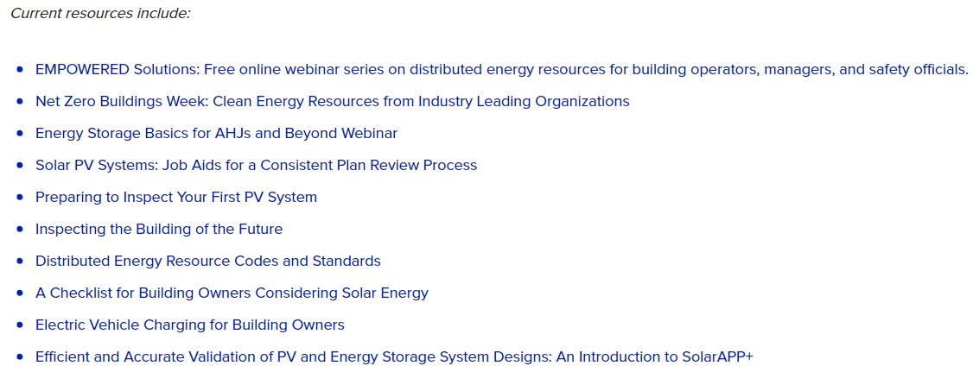
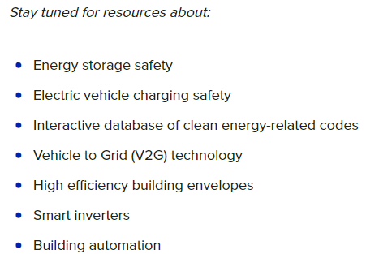
DER Learning Resource
https://sustainableenergyaction.org/clean-energy-clearinghouse/
A single source to learn about behind-the-meter DERs
Developed by an Interstate Renewable Energy Council (IREC)-led team including Slipstream
Target audience: building managers, operators, and safety officials

Slide 9
GEB Characteristics
Grid-Interactive Efficient Building Characteristics
Source: DOE, 2019
EFFICIENT
Persistent low energy use minimizes demand on grid resources and infrastructure
CONNECTED
Two-way communication with flexible technologies, the grid, and occupants
SMART
Analytics supported by sensors and controls co-optimize efficiency, flexibility, and occupant preferences
FLEXIBLE
Flexible loads and distributed generation/storage can be used to reduce, shift, or modulated energy use

Slide 10
GEB Controls

Slide 11
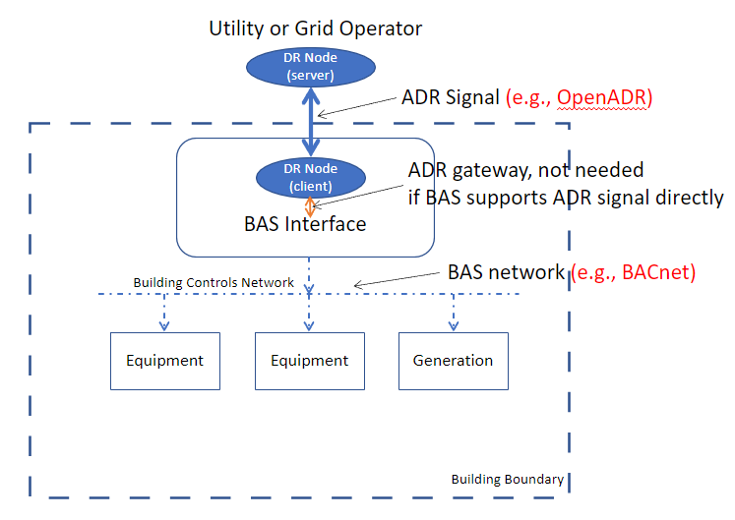
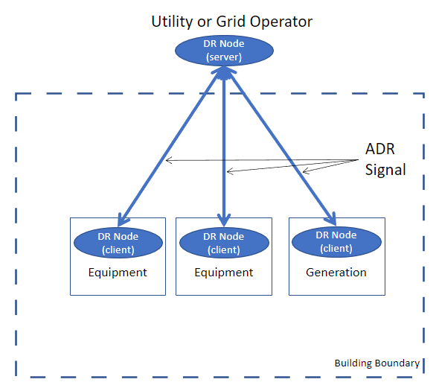
Different DER Control Models
Integrated
Distributed

Slide 12
A Generic GEB Control Platform
Connected
Integration
Integrate multiple DERs
Each subsystem may have its own standards/protocols
Two-way communication
Receive utility ADR signals
Respond with feedback info
Optimization and Control
Brain of a GEB building
Can optimize DERs based on multiple objectives
Highest utility incentives
Minimal carbon impact
Minimal energy use
Highest demand reduction
Acceptable comfort levels
Smart
Flexible
Connected

Slide 13
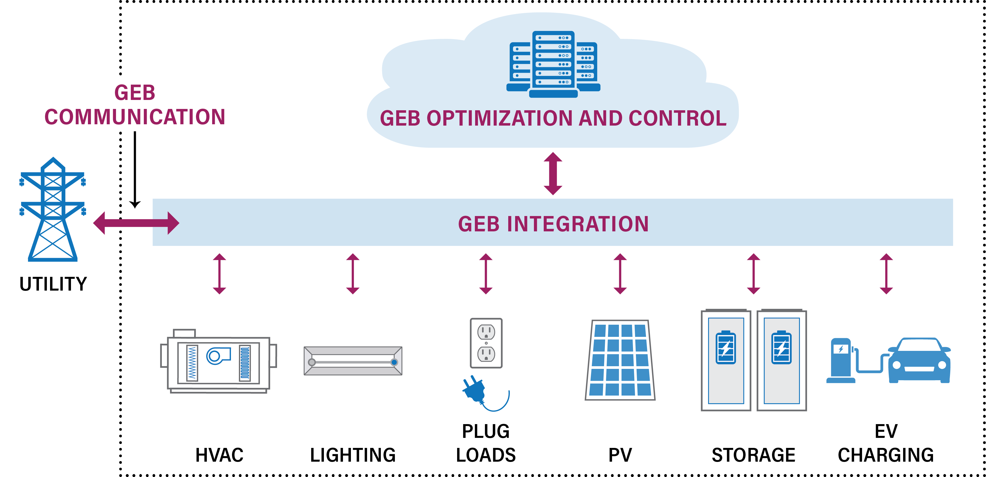
A Generic GEB Control Platform
BAS

Slide 14
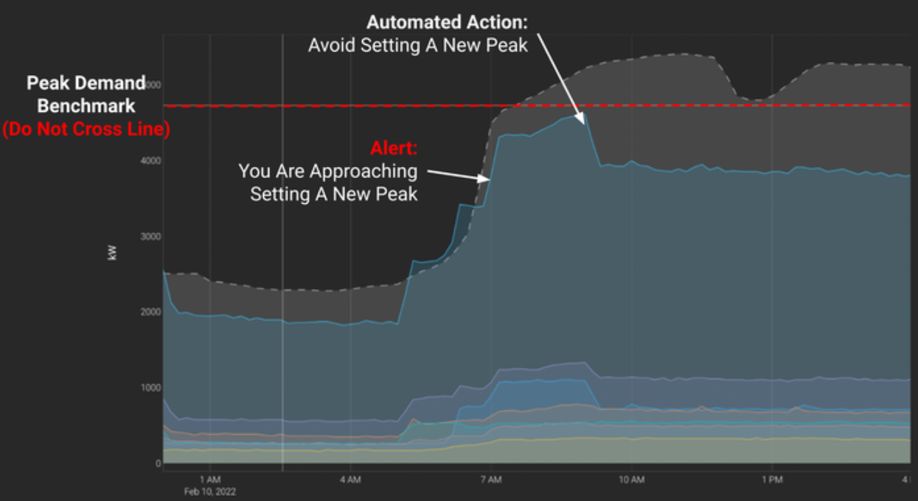
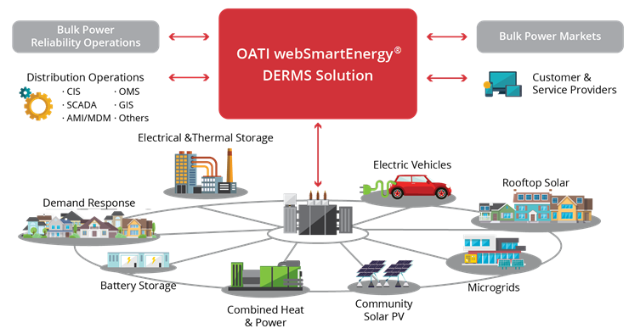
Current GEB Control Software Options
Open-source platform
Eclipse VOLTTRON
Proprietary, commercial software
Prescriptive Data - Nantum
Kinetic Buildings – Synapse
Others
DERMS (not GEB Control)
Distributed Energy Resource Management System
Utility-side control

Slide 15
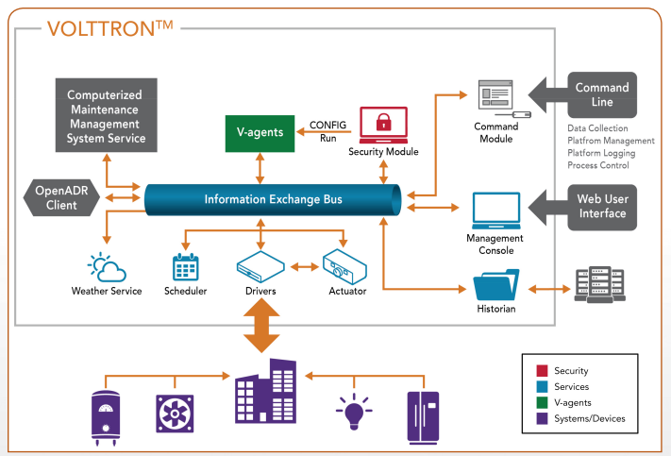
Eclipse VOLTTRON
VOLTTRON
A Linux-based software platform
Enables secure coordination of building energy loads and distributed energy resources
Initially developed by PNNL
Open-source, publicly available from GitHub
Optimization and control
Communication
Integration
Source: Pacific Northwest National Lab

Slide 16
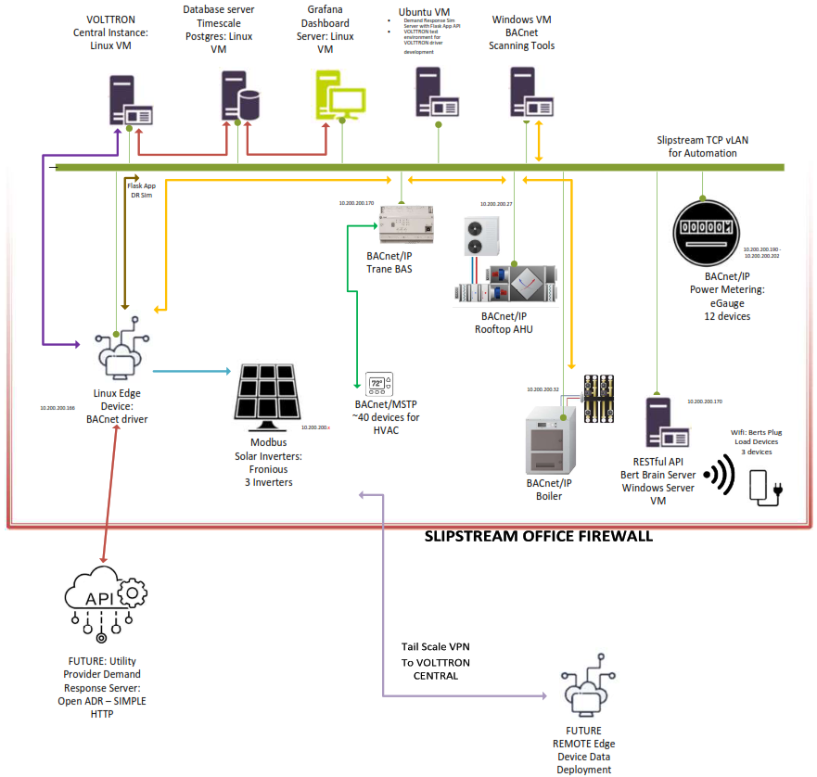
Slipstream GEB Platform Architecture
HVAC
Meter
PV
Plug Loads
An industrial-grade computer with VOLTTRON installed
ADR
Aggre-gation

Slide 17
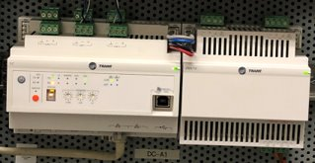
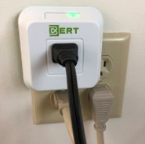
Slipstream GEB Platform Components
Computer with VOLTTRON
Building HVAC Control
BERT Smart Plug
Solar PV Inverter

Slide 18
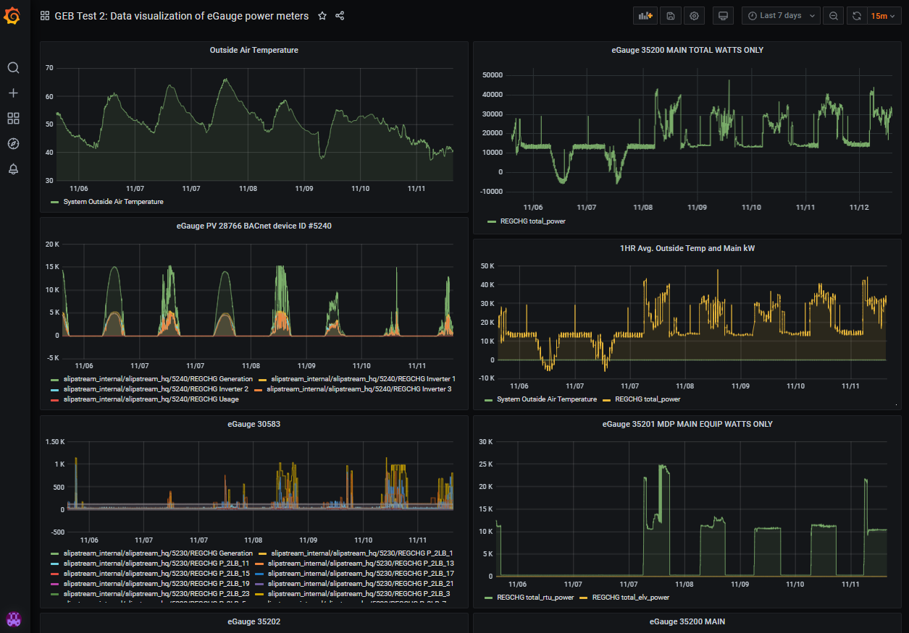
Slipstream GEB Platform User Interface
Grafana
A web-based visualization tool
Open source
Configurable and flexible
Connected to Slipstream GEB database
OA Temp
Main Power
PV Power
RTU Power

Slide 19
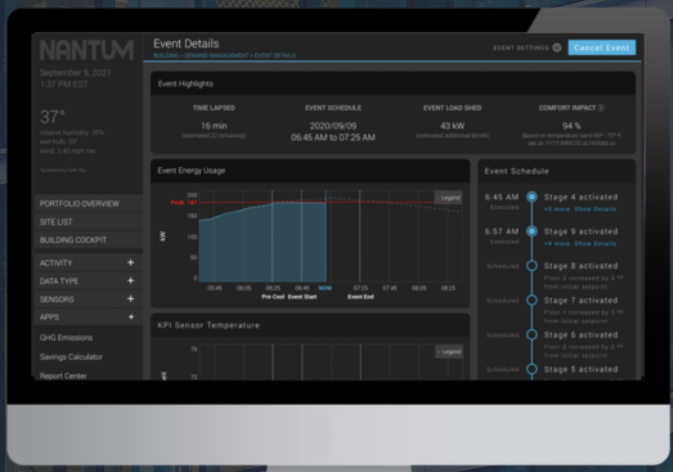
Prescriptive Data - Nantum

Slide 20
Kinetic Buildings - Synapse
Automated set-up and calibration
During the normal course of a building’s operation, the manner in which each piece of equipment responds to changes is continuously tracked
Setpoint and actuator changes vs. the power and thermal responses
EMIS platform
Analytics cloud
Web application
Dashboarding and reporting
Real-time monitoring-based Cx (MBCx)
Configuration of efficiency opportunities and actions
Configuration of demand shedding & shifting actions
Database
Weather forecast
Process
Estimate future demand
Estimate effects of all potential adjustments – bounded by operator
Minimize and distribute impact to occupants
Continuously learn and calibrate
Building automation IP subnet
Grid/utility data
(multiple protocols)
Volttron edge node
Router/Switch
BAS workstation

Slide 21
Current GEB Control Software Capabilities
Still mostly only focuses on load reduction through HVAC controls
Need to integrate other DERs
Lighting & plug loads
Solar PV and battery storage
Managed EV charging
Automated Demand Response
Two-way communications with utilities (OpenADR, IEEE 2030.5)
Realtime pricing
Optimization and control
Optimize all DERs
Multiple objectives
kWh savings
kW reduction during peak periods
kWh and kW $ savings
Utility incentives
Carbon emission reduction
Comfort
Still mostly in research and testing

Slide 22
What Knowledge Building Engineers Need to Know
Building automation system
GEB control platform
GEB DER integration
Building-to-grid communication
OT vs IT & cybersecurity
HVAC control strategies for load reduction
How other DERs are operated and maintained
General optimization techniques

Slide 23
Automated Demand Response Through GEB Controls

Slide 24
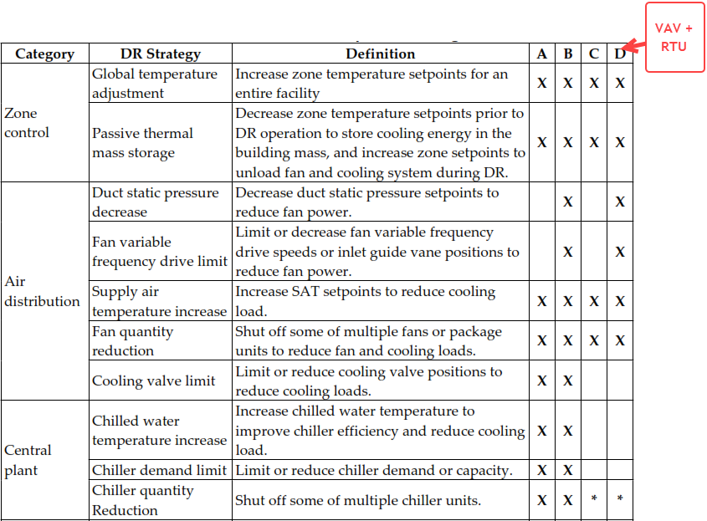
Automated Demand Response Through GEB Controls
Source: LBNL

Slide 25
Lessons Learned
Method: Increase zone temperature setpoint by 2 Deg F
Issue #1 - zone temperature setpoint deadband too narrow
More simultaneous heating and cooling
During load shedding event, the zones can be in heating mode
Recommend at least 5 deg F
Adjusting the deadband may be proprietary software tools and done by the building controls contractor
75 Deg F
74 Deg F
73 Deg F
Zone Temp
72 Deg F

Slide 26
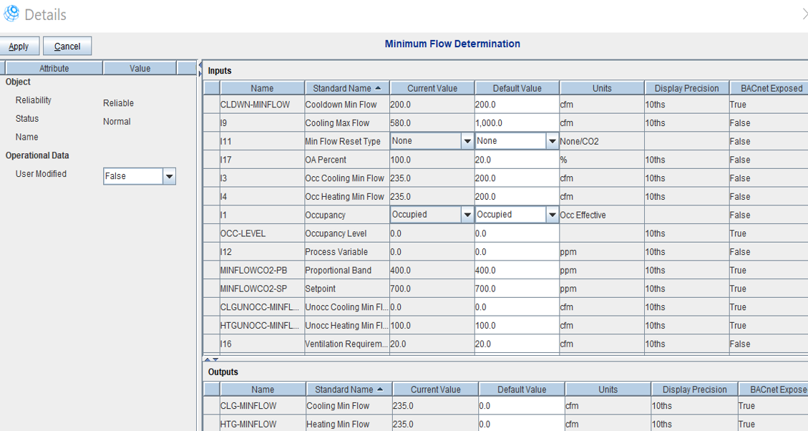
Lessons Learned
Method: Increase zone temperature setpoint by 2 Deg F
Issue # 2 – improper VAV minimum airflow settings
Exiting buildings could set VAV minimum airflows too high, so the VAV system normally runs as a CAV system
Adjusting the deadband may need a proprietary software tools and can only be done by the building controls contractor

Slide 27
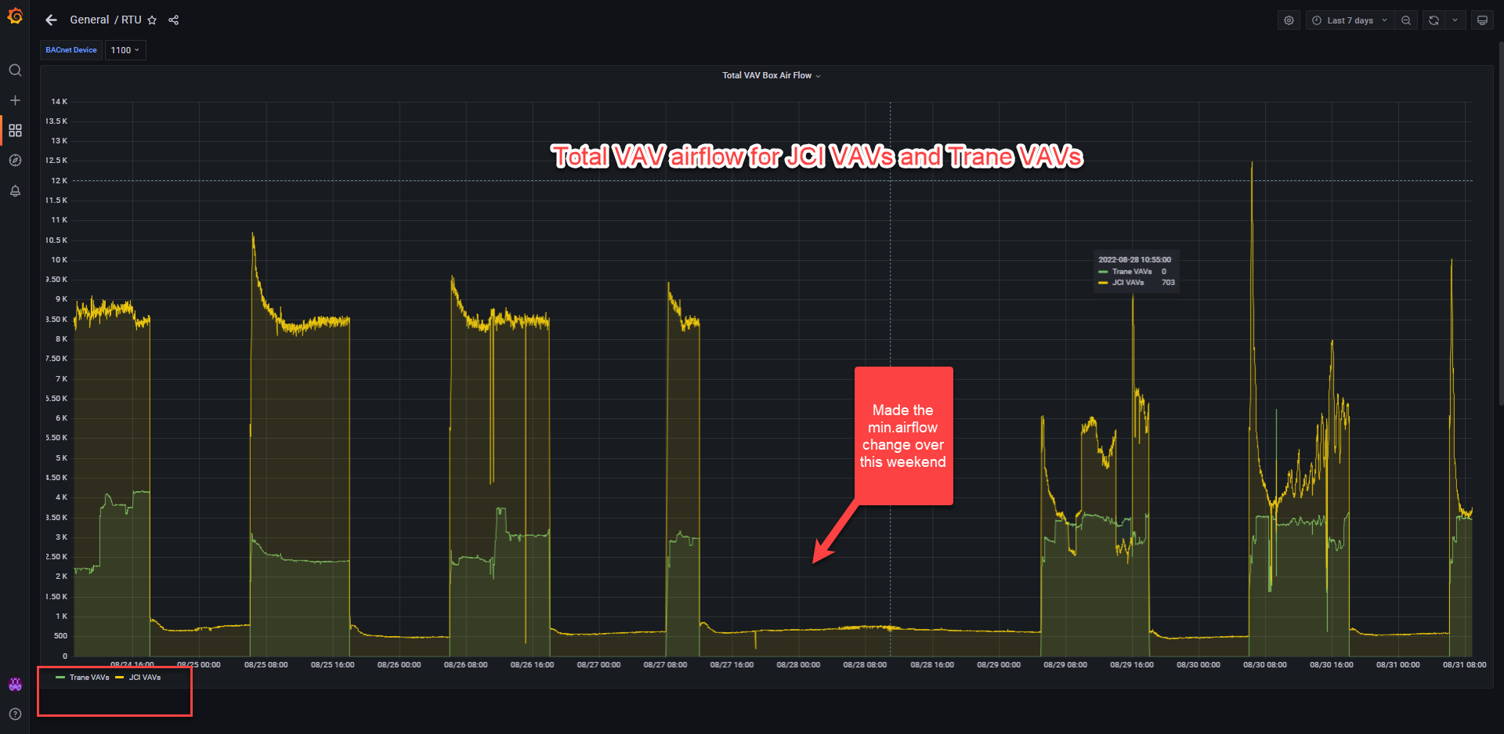
Minimum Airflow Adjustment

Slide 28
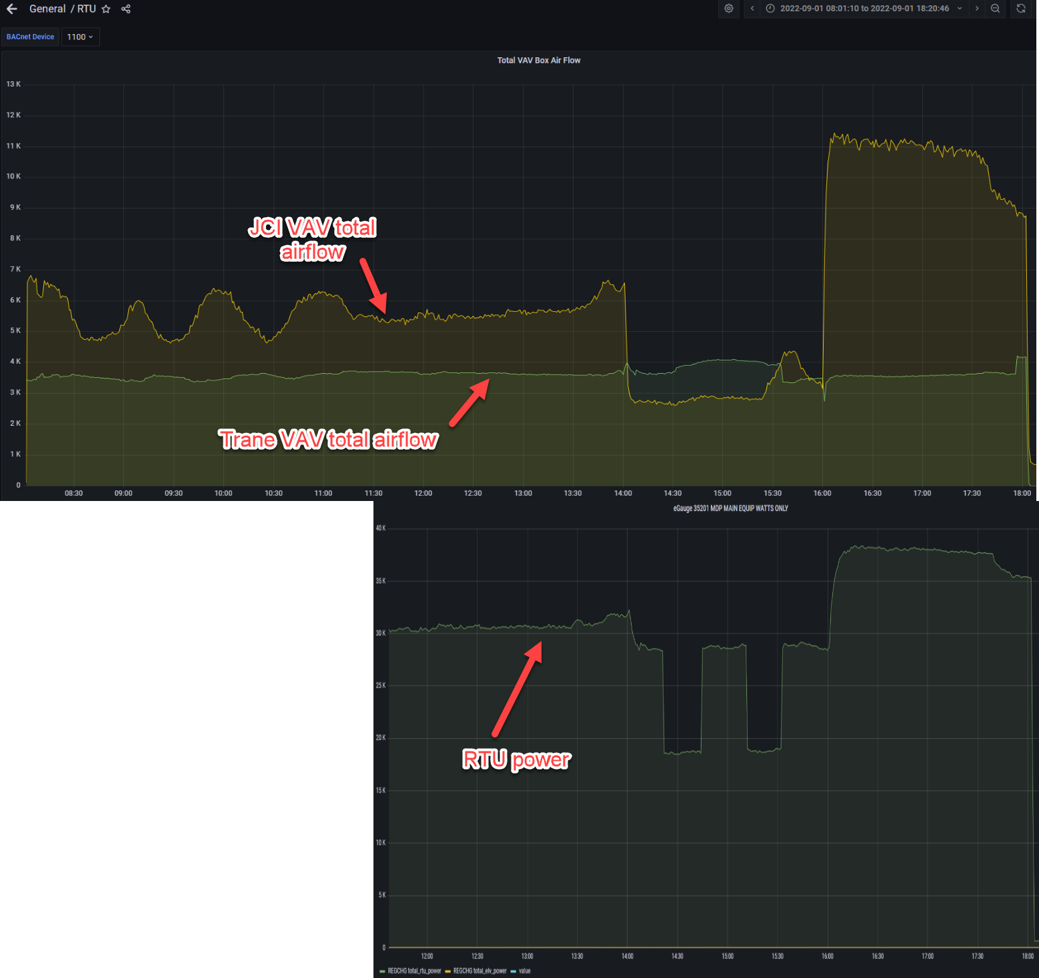
An Example
Event start
Event end
An ADR test day
Simulated peak load event from 2 – 4pm
RTU power dropped from ~30kW to ~20kW
Rebound effect
Trane VAV min. still not adjustable

Slide 29
Lessons Learned and Future GEB Research/Demonstration
VOLTTRON
Integration other DERs
- Open source, cost effective
- Steep learning curve
- Solar PV + battery storage
- EV charging
Need to fix BAS issues first
Automated Demand Response
- Zone setpoint deadband
- VAV min. airflow adjustment
- OpenADR
- IEEE 2030.5
Value proposition is key
DER Optimization and Control
- Value to building owners
- Value to utilities
- Optimize and control all DERs
- Muti-objective optimization

Slide 30
Questions and Discussion
Xiaohui “Joe” Zhou, PhD, PE, CEM
Director of Research and Innovation
jzhou@slipstreaminc.org

